Slide 1
Efficiency and Bus Fleet Management:
Sustainable Mobility Team
Partner Briefing — Gandhinagar Municipal Corporation
04 August 2026
© Council on Energy, Environment and Water, 2026

Slide 2






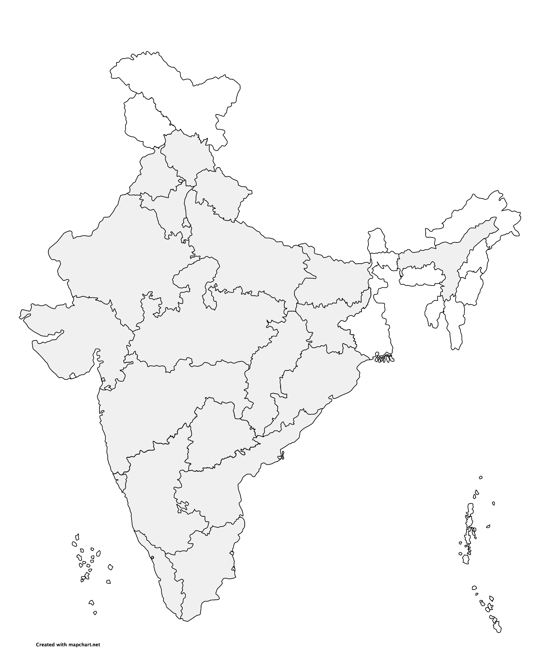
Impacting sustainable development at scale with data, integrated analysis, and strategic outreach
STRATEGIC PILLARS
Clean electricity
Low-carbon
industrialisation
Fuels of the future
Improving quality of life
Green economy & livelihoods
Sharing lessons from India
Himachal Pradesh
Resilience
Uttarakhand
Energy, Resilience
16 years
16 research teams
400+ team members
680+ peer-reviewed studies
240+ policies & plans informed
80,000+ livelihoods enabled
770+ convenings
800+ opinion pieces
52 mn reached via films & documentaries
Punjab
Air, Mobility
Assam
Energy, Livelihoods
Haryana
Air, Energy
Uttar Pradesh
Energy, Mobility, Water
Delhi
Air, Energy, Mobility
Bihar
Air, Livelihoods
Rajasthan
Air, Energy, Food, Industry, Water
Gujarat
Air, Energy, Industry, Resilience, Water
Jharkhand
Energy
Chhattisgarh
Energy, Mobility
Madhya Pradesh
Air, Energy, Food
Odisha
Energy, Livelihoods, Resilience
Maharashtra
Air, Energy, Resilience, Water
Telangana
Mobility
Goa
Resilience, Water
Karnataka
Energy
Andhra Pradesh
Resilience, Food
Kerala
Energy, Mobility
Tamil Nadu
Air, Energy, Resilience,
Water
Notes:
18 states, 52 ongoing engagements.

Slide 3

Impacting sustainable development at scale with data, integrated analysis, and strategic outreach
TRANSFORMATIONS
QUALITY OF LIFE
ENABLERS
Low-carbon Economy
Clean Air
Sustainable Finance
Energy Transitions
Sustainable Water
Technology Futures
Power Markets
Sustainable Food Systems
Circular Economy
Industrial Sustainability
Sustainable Cooling
Climate Resilience
Sustainable Livelihoods
Sustainable Mobility
International Cooperation
SPECIAL INITIATIVES
CEEW Green Finance Centre
Powering Livelihoods
Emerging Economies
UP State Office

Slide 4
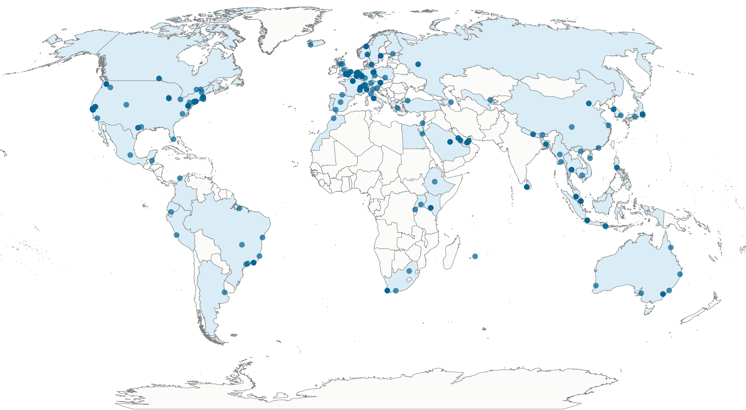
Global collaborations since 2010
60+ countries
230+ institutions
4|

Slide 5
BBUS: the project’s key components
M1 - Socio-economic co-benefits, especially for women, low-income groups, & vulnerable road users
M2 - Health and air quality benefits from increased bus usage and reduced reliance on private vehicles
4-in-1 co-benefits model of bus-based public transport
M3 - Greenhouse gas (GHG) mitigation potential benefits
of bus deployment
M4 - Resilience & adaptive benefits of robust bus transport on the economy and physical infrastructure
Easing access to climate, green funds and other potential avenues for bus and allied infrastructures
Build institutional support for bus systems through strategic communication

Slide 6
Our approach: how we're building the evidence
BBUS pairs lived-experience research — interviews and focus groups with bus users and non-users — with a structured survey across 6 Indian cities, split between control and treatment groups.
Group A — cities with buses already running
Group B — cities where buses are about to launch
Bengaluru, Jaipur, Bhubaneswar. A cross-sectional comparison of bus users, non-users and private-vehicle users — estimating today's co-benefits.
A before/after (Difference-in-Differences) comparison of the same residents, tracked pre- and post-deployment — isolating the true causal effect of bus access.
For Group B cities, the same survey also feeds route-level planning:
1
Conduct the survey
Travel behaviour, current mode, trip patterns
→
2
Map travel patterns & gaps
Which areas and routes are under-served, using GIS
→
3
Route-level plan for e-buses
Where new routes & stops are needed most

Slide 7
What we'll do: from evidence to investment-ready tools
Stages that turn co-benefit evidence into a financeable case for bus investment.
STAGE 1
Review & design
Synthesise global evidence; finalise survey tools through interviews and focus groups with bus users and non-users
STAGE 2
Primary data collection
A structured survey of 6,000 respondents across 6 Indian cities — Group A and Group B
STAGE 3
Build the 4-in-1 models
Quantify socio-economic (M1), health (M2), GHG (M3) and resilience (M4) co-benefits
STAGE 3B
Route planning for e-buses (Group B)
Turn survey travel-pattern data into route and stop recommendations for cities about to deploy e-buses
Each stage produces something usable on its own — you don't have to wait for the final report to get value.

Slide 8
What this produces: an investment-ready toolkit
Every model feeds into one practical output — a tool that turns co-benefit evidence into financeable numbers.
The Pre-Investment Appraisal Tool
Input: fleet size, city population, current modal share, grid emission factor → Output: projected GHG savings, health co-benefits (DALYs averted, hospitalisation costs saved), an SROI ratio, eligible climate-finance instruments, and an MRV dashboard aligned to India's NDC, state targets and the SDGs
Built to speak to three audiences, from the same underlying data:
Government
value-for-money — societal co-benefits per rupee of public spend
Climate & development finance
metrics structured for GCF, ADB and World Bank appraisal
Private sector & capital markets
de-risking data for blended finance and revenue guarantees
Source: CEEW compilation

Slide 9
Working together
None of this works without a partner on the ground. Here's what would help:
Access to route, ridership and fleet data, where available
Support connecting with the local transport agency for on-ground survey access
A nodal contact for coordination through the data-collection period
A short window to feed findings back as they take shape — this is meant to be useful to you, not just about you

Slide 10
Thank you
ceew.in | @CEEWIndia

